Slide 1


ASTOS Model Setup –
Sub-Orbital Rocket Trajectory Modelling
Jason Ong

Slide 2

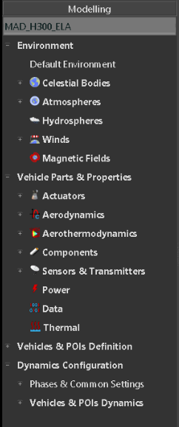
High Level Overview
Planet model (Earth)
Atmospheric model (US 76)
Wind model (custom or generic)
Thrust curve
Modular
Aerodynamic tables
Aerothermal data (not required for now)
Masses and dimensional data
Sensors (IMU etc.) (not required for now)
Component Integration
Trajectory Phase Settings
Model Integration

Slide 3
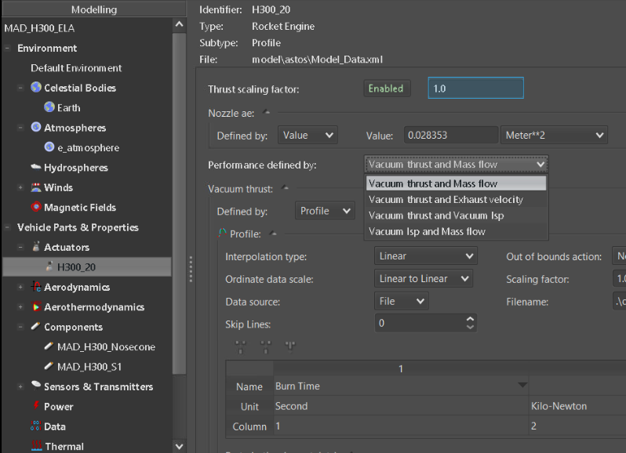
Thrust Model
Performance definition variations
Typically vacuum thrust and mass flow is selected
For simplification, mass flow is usually set as constant value

Slide 4
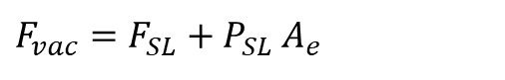
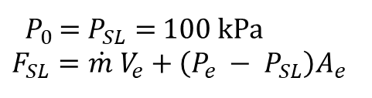
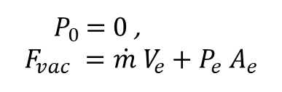
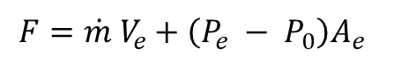
Thrust Model
General Thrust Equation
$$F=\dot{m} V_{e}+\left(P_{e} − P_{0}\right)A_{e}$$
For vacuum thrust,
${ P}_{0 }=0$ ,
$$F_{vac} =\dot{m} V_{e}+P_{e} A_{e}$$
For sea level thrust,
${ P}_{0}$ = $P_{SL}=$100 kPa
$$F_{SL}=\dot{m} V_{e}+\left(P_{e} − P_{SL}\right)A_{e}$$
Conversion of SL thrust to vacuum thrust:
$$F_{vac}=F_{SL}+P_{SL}{ A}_{e}$$
Vacuum thrust curve data as Astos input
Propulsion thrust curve data
Nozzle exhaust area as input

Slide 5
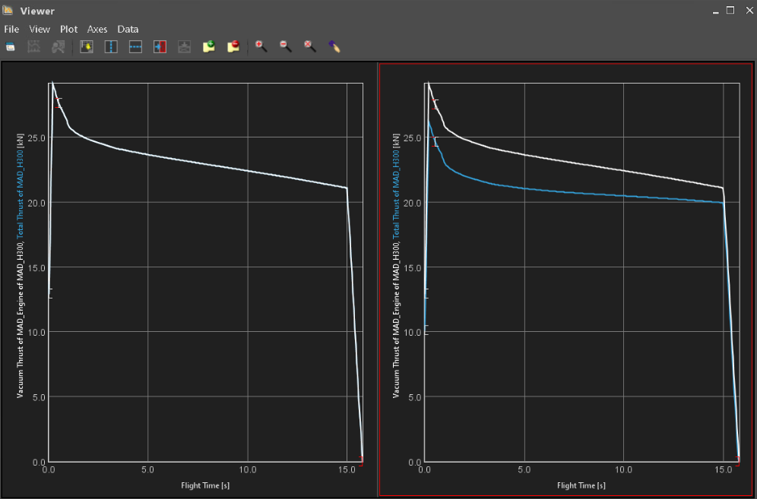
Thrust Model
Total Thrust = Vacuum Thrust
Nozzle exhaust area = 0
Nozzle exhaust area ≠ 0

Slide 6
Thrust Model

Slide 7
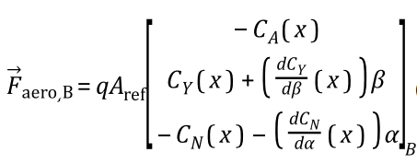
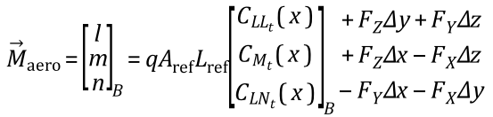
Aerodynamics Model
Force and moment equations in body-fixed coordinates

Slide 8
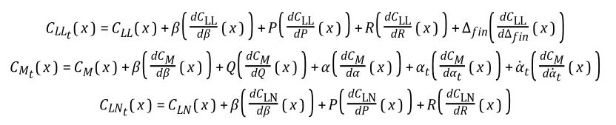
Aerodynamics Model
Moment Coefficients Computation (Astos Model Reference)
Currently Used

Slide 9
Aerodynamics Model
For rotational symmetry, we assume:
=
=
Equivalent notations when compared to other literature:
− C_{NA}
− C_{MQ}
− C_{yβ}
− C_{NR}
− C_{LP}
− C_{Lδ}

Slide 10
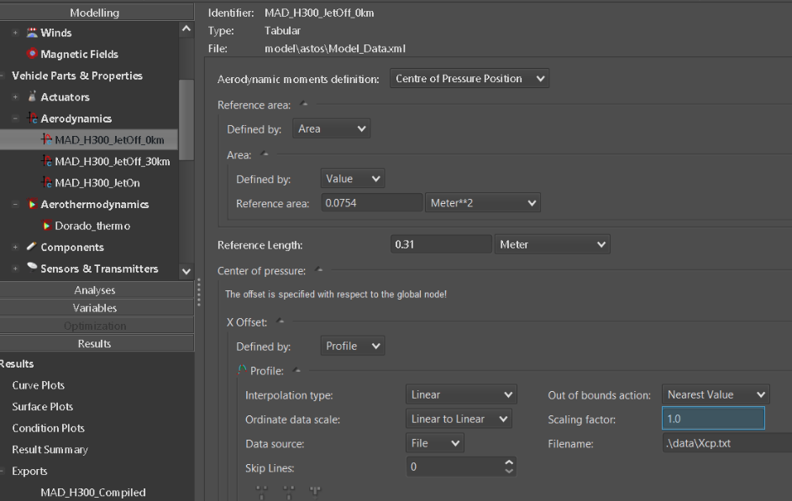
Aerodynamics Model
Definition of Reference Quantities
Length and area
XCP point is relative to where global node is positioned.

Slide 11
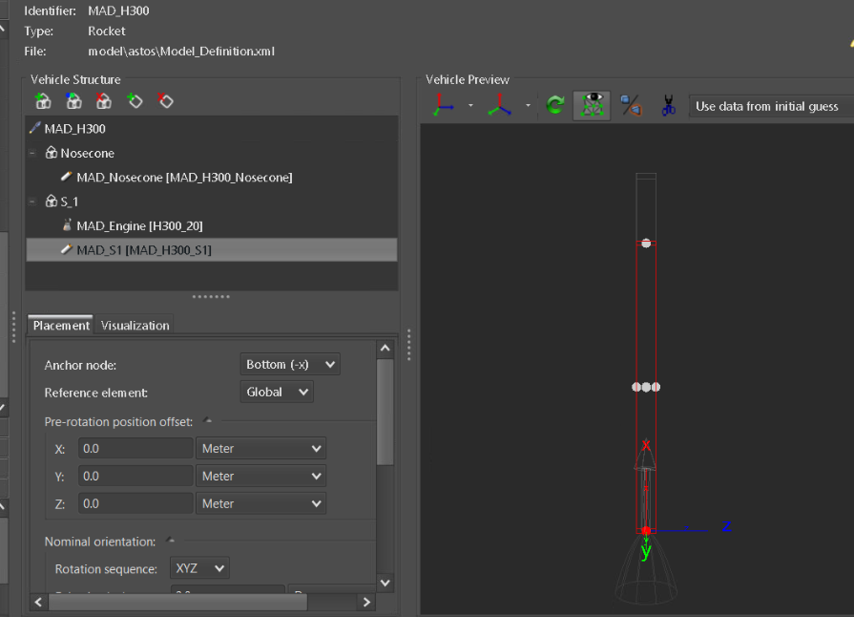
Aerodynamics Model
Global Node Placement
In this case, XCP is defined +ve since global node is at the bottom. In the case where global node is placed at tip of nose, XCP should be defined –ve.

Slide 12
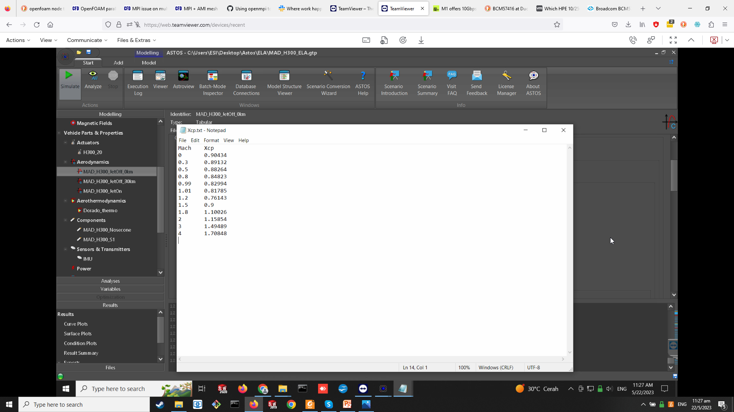
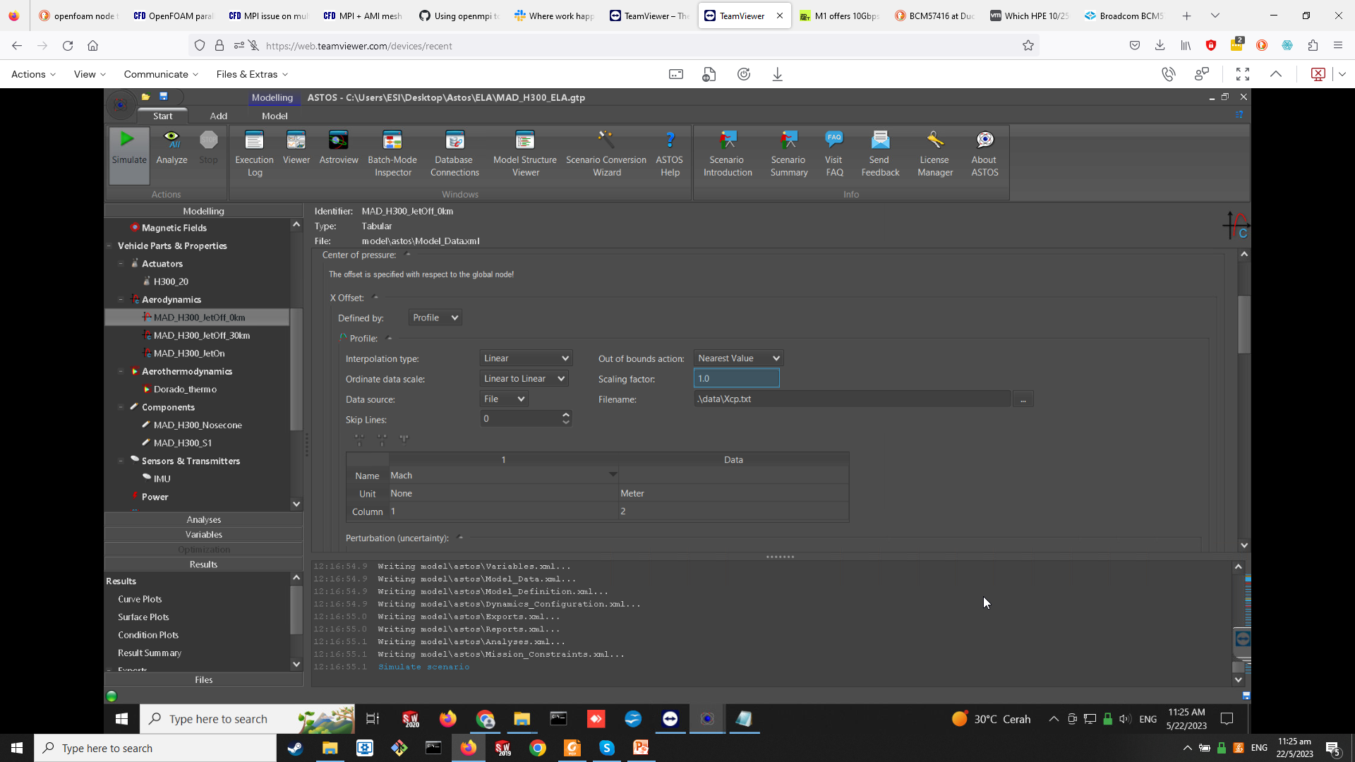
Aerodynamics Model
1D Interpolation
2nd column: Xcp
1st column : Mach (Values must be monotonically increasing)

Slide 13
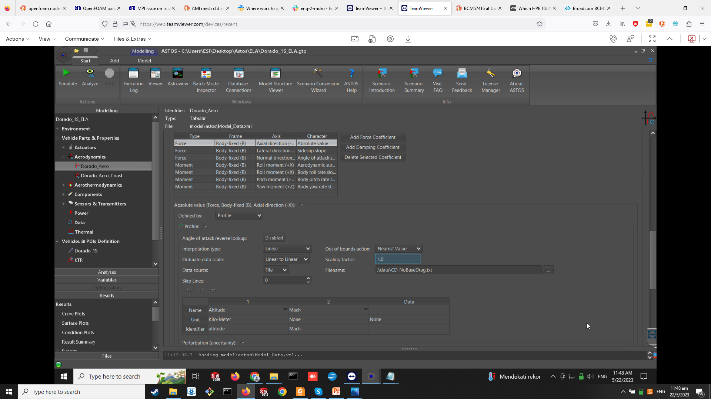
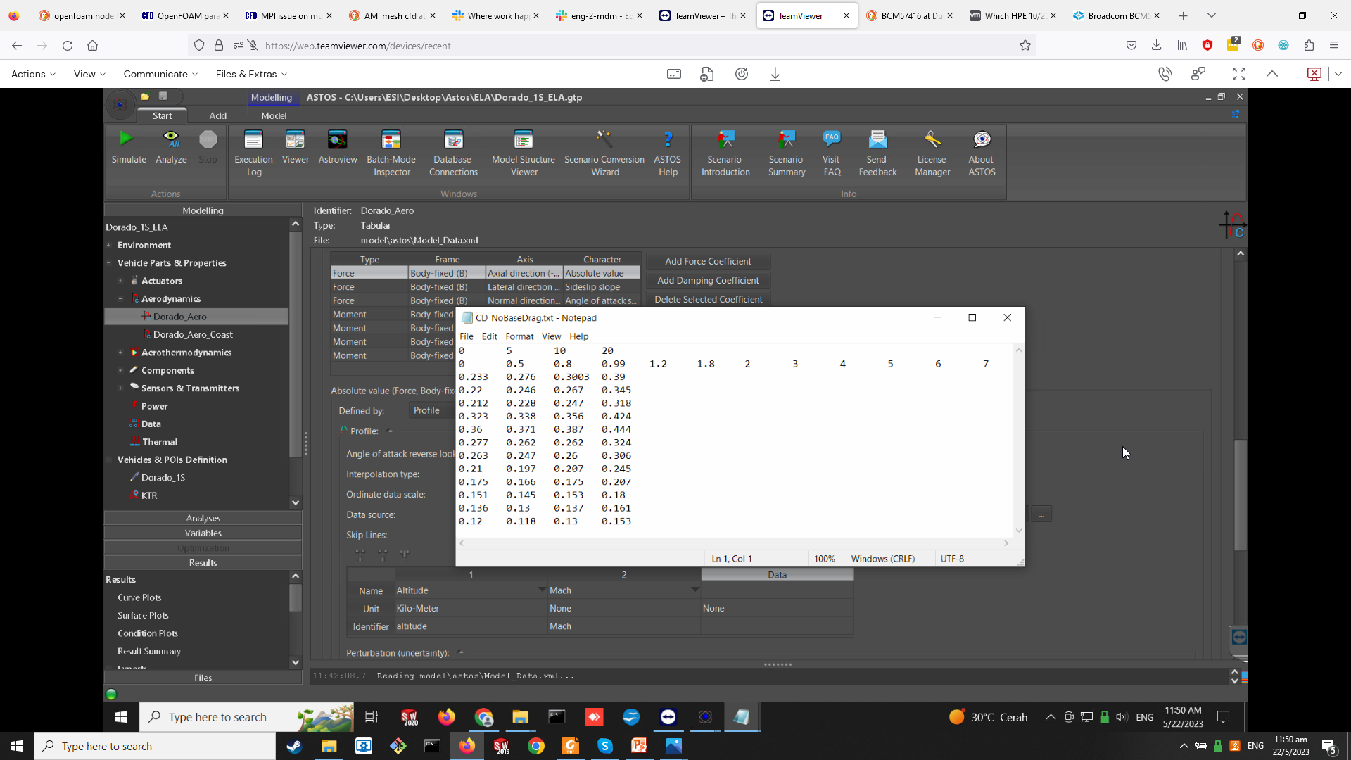
Aerodynamics Model
2D Interpolation
1
2
Data

Slide 14
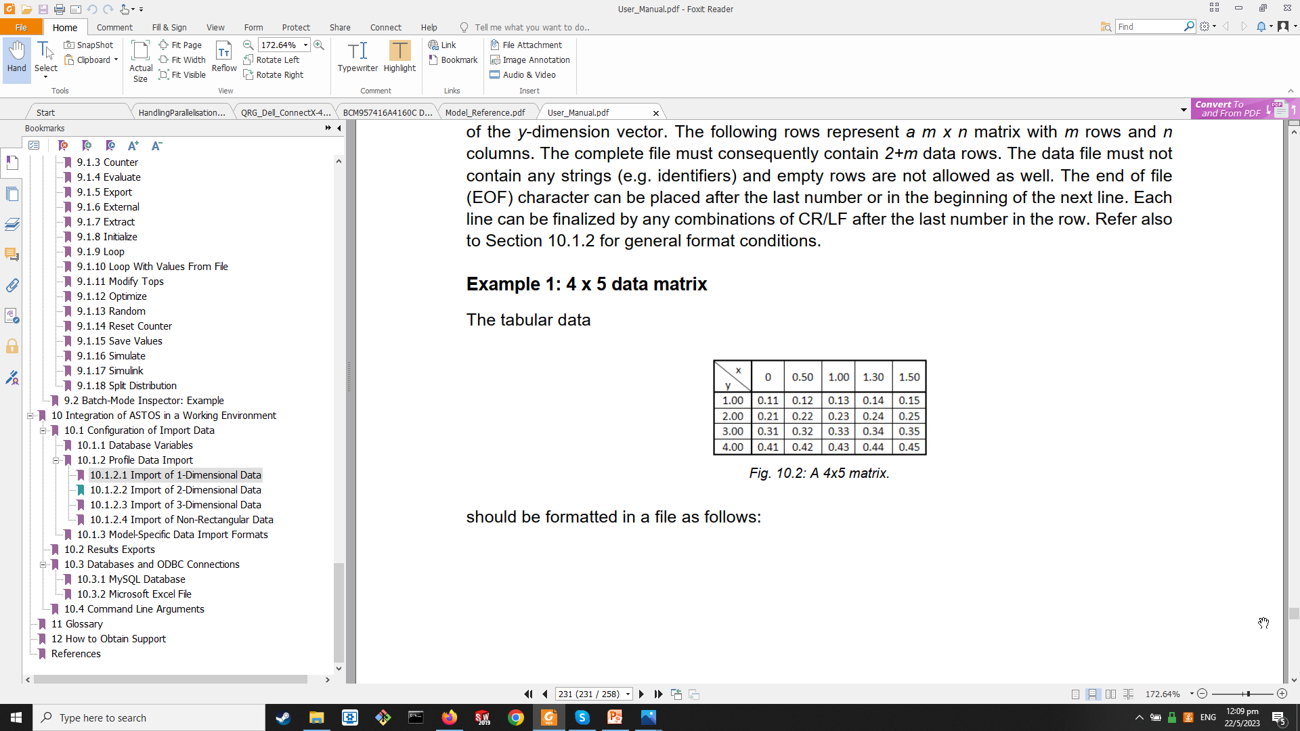
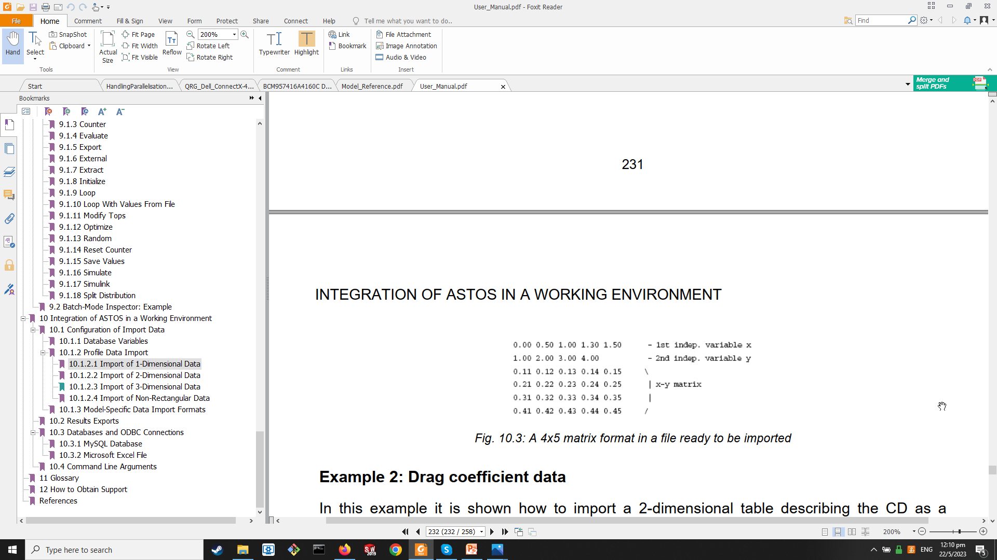
Aerodynamics Model
2D Interpolation (according to Astos)

Slide 15
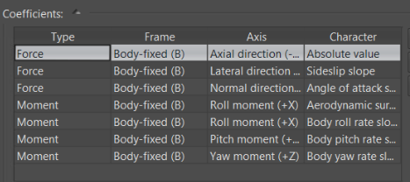
Aerodynamics Model
Coefficients
C_{D}
C_{yβ}
C_{NA}
C_{LP}
C_{Lδ}
C_{MQ}
C_{NR}

Slide 16
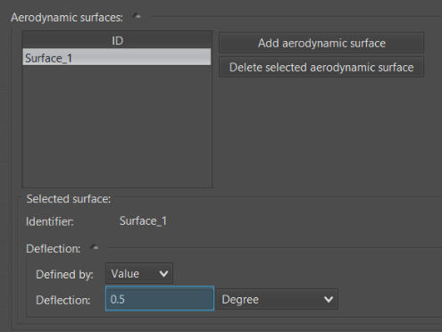
Aerodynamics Model
Fin Cant
Define fin cant angle

Slide 17
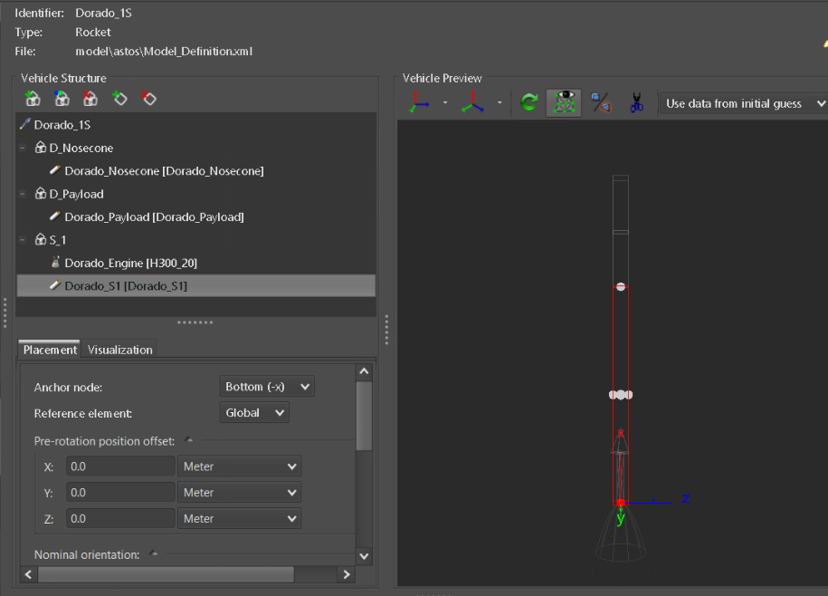
Vehicle Definition
Specify components in use
Define component position using anchor node placement, and position/rotation offsets

Slide 18
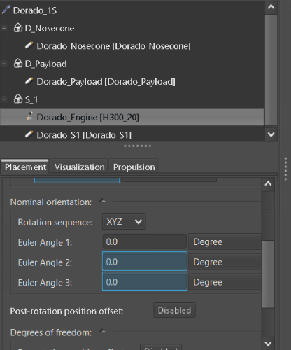
Vehicle Definition
For specifying thrust misalignments during Monte Carlo simulations

Slide 19
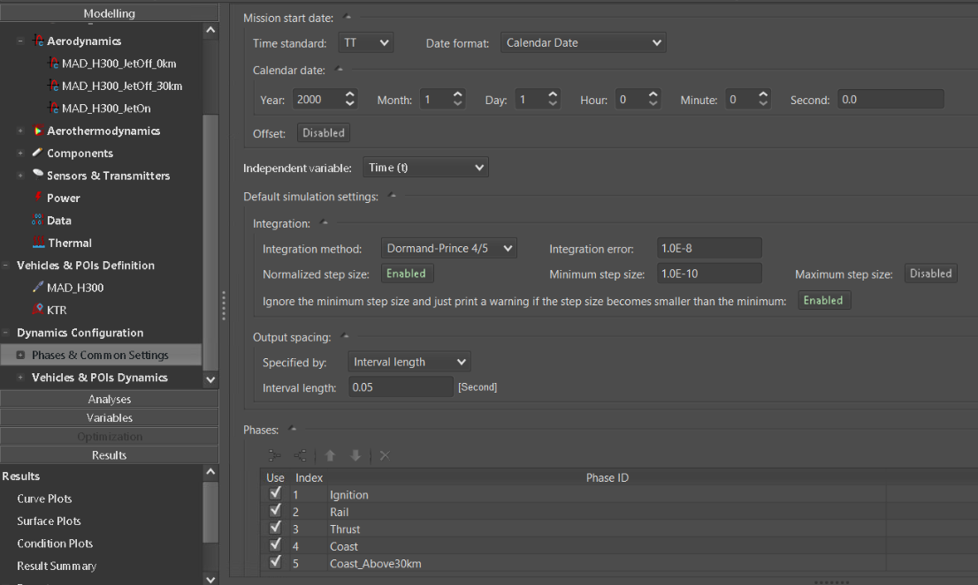
Phase Definition
Overall
Timestep
Phase selection for trajectory simulation

Slide 20
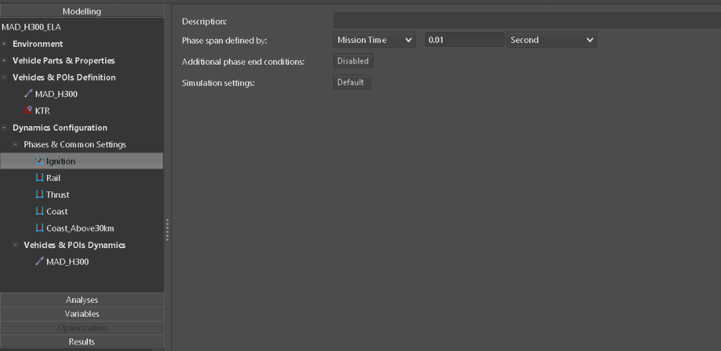
Phase Definition
Ignition Phase
Ignition start time on thrust curve

Slide 21

Phase Definition
Rail Phase
“Enabled” for boolean condition to work
Boolean condition: phase ends when altitude > launch rail height
No. of phases vary from case to case, depends on dynamics of trajectory phases
Phase ends when
Boolean condition is reached, OR
Phase span reaches mission time or phase time defined

Slide 22

Phase Definition
Thrust Phase
End time on thrust curve

Slide 23

Phase Definition
Coast Phase
Boolean condition: phase ends when altitude > 30 km

Slide 24

Phase Definition
2nd Coast Phase
Boolean condition: phase ends when altitude < 0 km

Slide 25
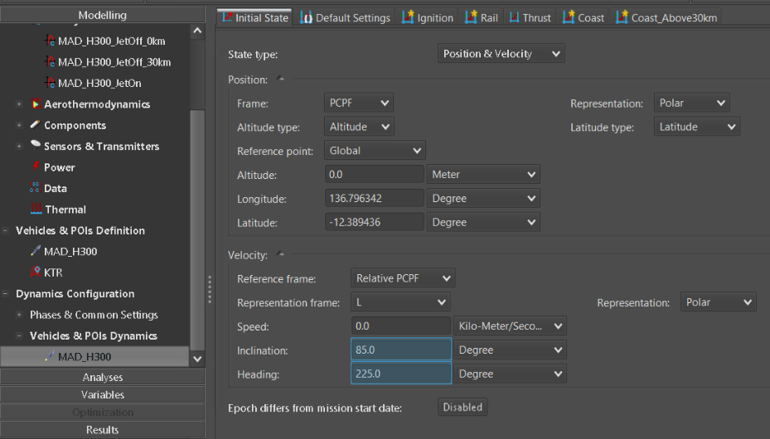
Trajectory Parameters
Initial State
Lat, long, alt
Speed, inclination, heading

Slide 26
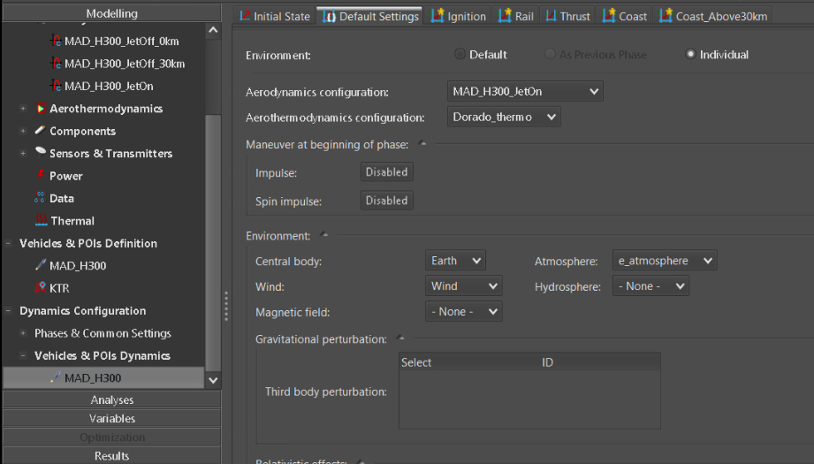
Trajectory Parameters
Default Settings
Default aerodynamics model: No base drag

Slide 27
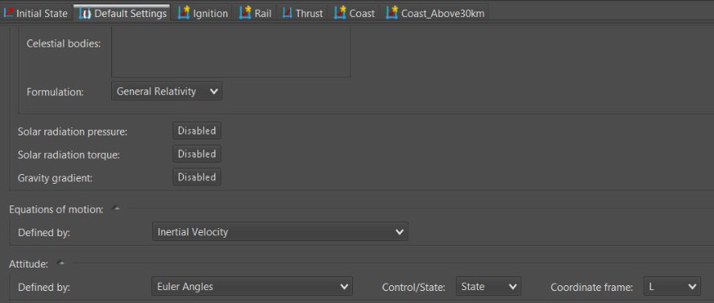
Trajectory Parameters
Default Settings
Default equation of motion and attitude control laws used

Slide 28
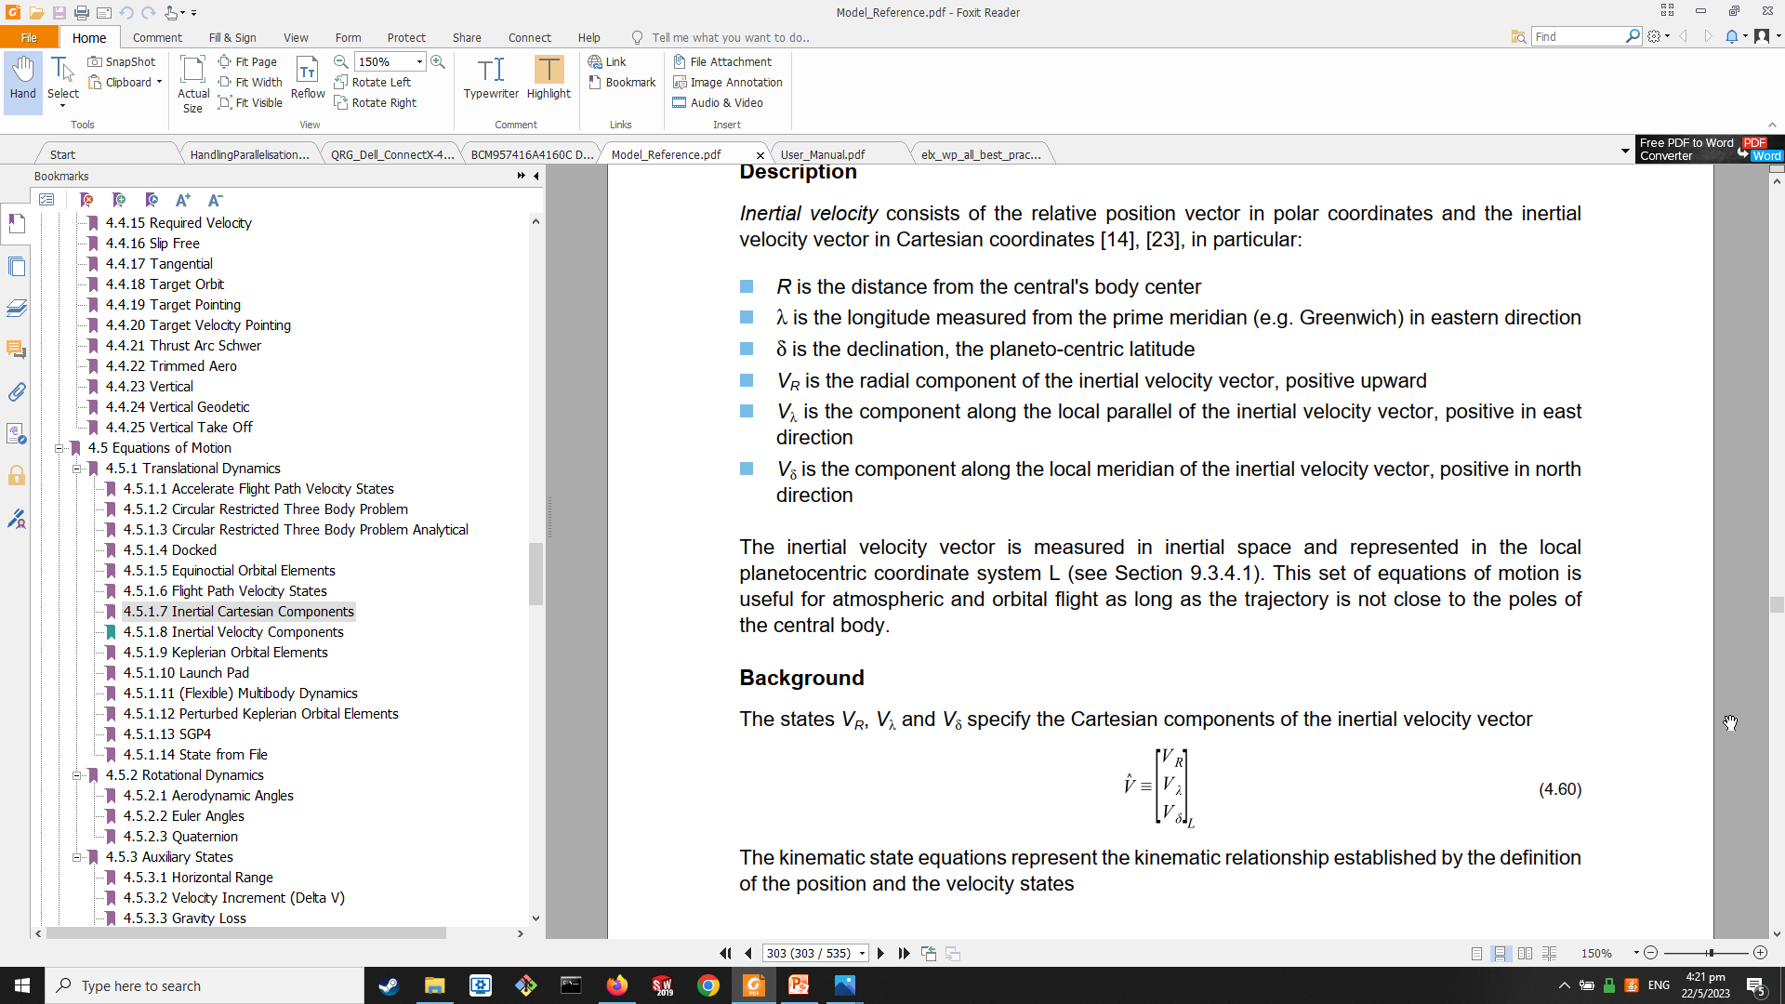
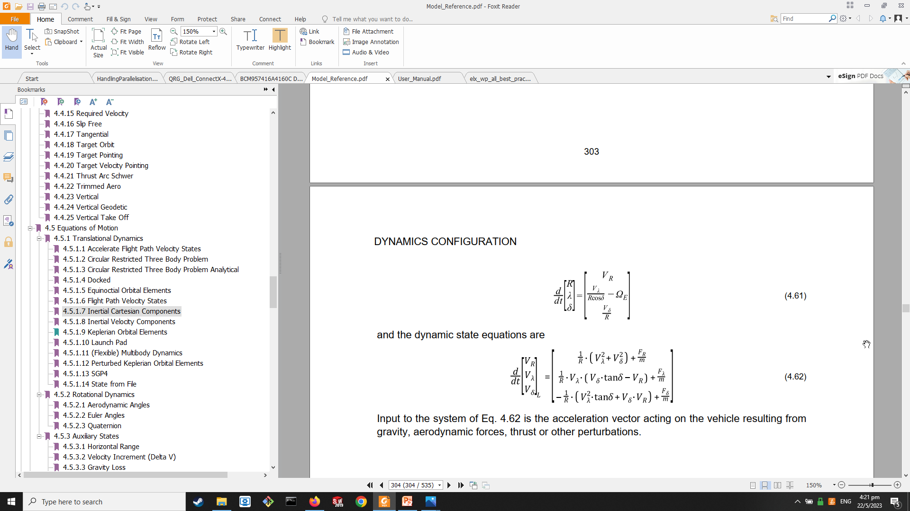
Trajectory Parameters
Equations of Motion: Inertial Velocity(Astos Model Reference)

Slide 29
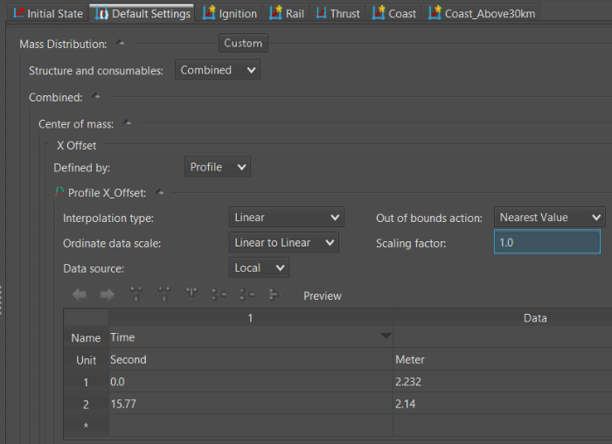
Trajectory Parameters
Default Settings
Default CoM

Slide 30
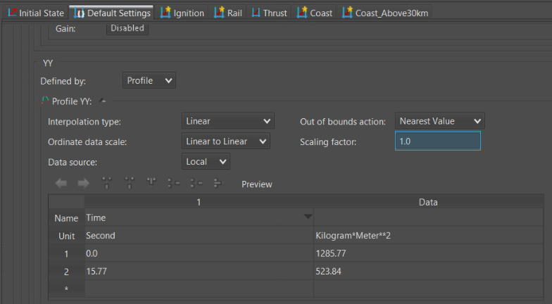
Trajectory Parameters
Default Settings
Default MoI (YY) (Same for ZZ)

Slide 31
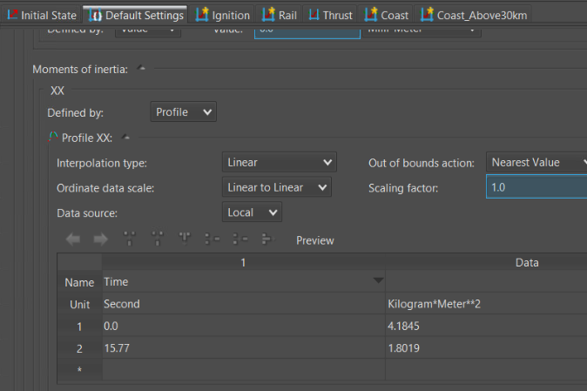
Trajectory Parameters
Default Settings
Default MoI (XX)

Slide 32
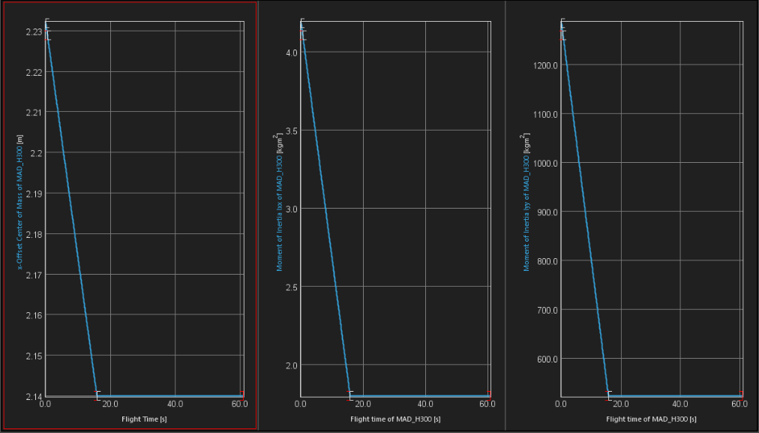
Trajectory Parameters
Default Settings
CoM
MoI - XX
MoI - YY
Verification of default settings

Slide 33
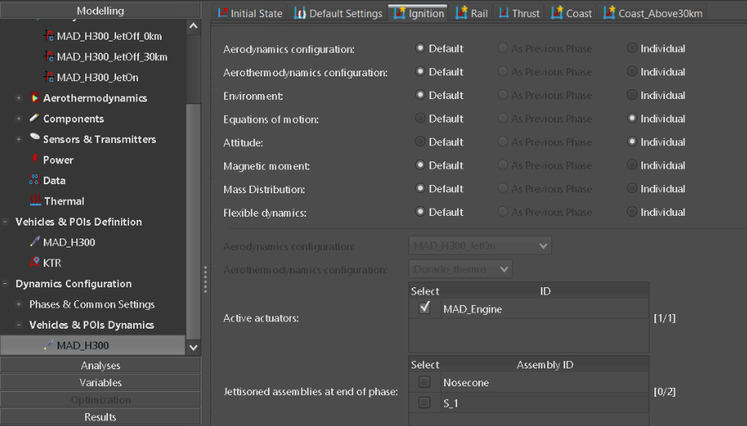
Trajectory Parameters
Dynamics - Ignition
Active motor

Slide 34
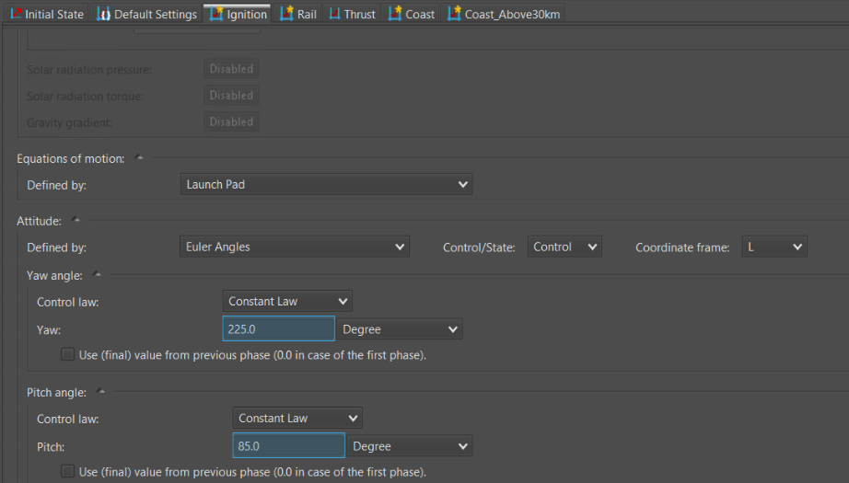
Trajectory Parameters
Dynamics - Ignition

Slide 35
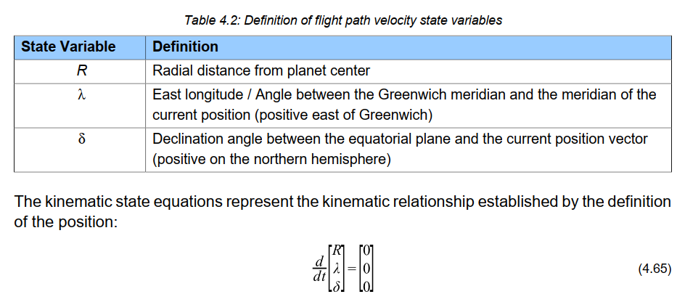
Trajectory Parameters
Equations of Motion: Launch Pad (Astos Model Reference)

Slide 36
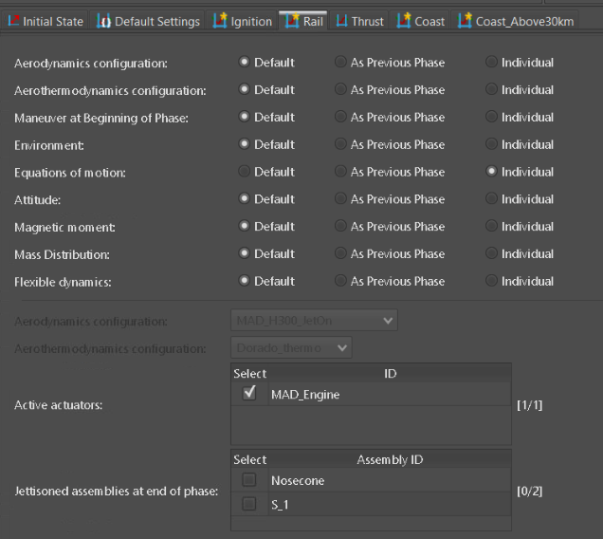
Trajectory Parameters
Dynamics - Rail
Active motor

Slide 37
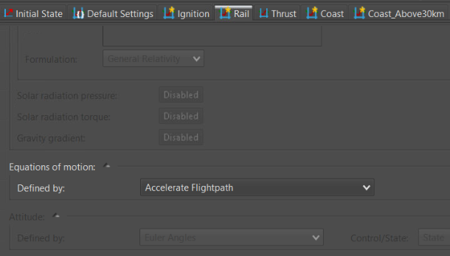
Trajectory Parameters
Dynamics - Rail

Slide 38
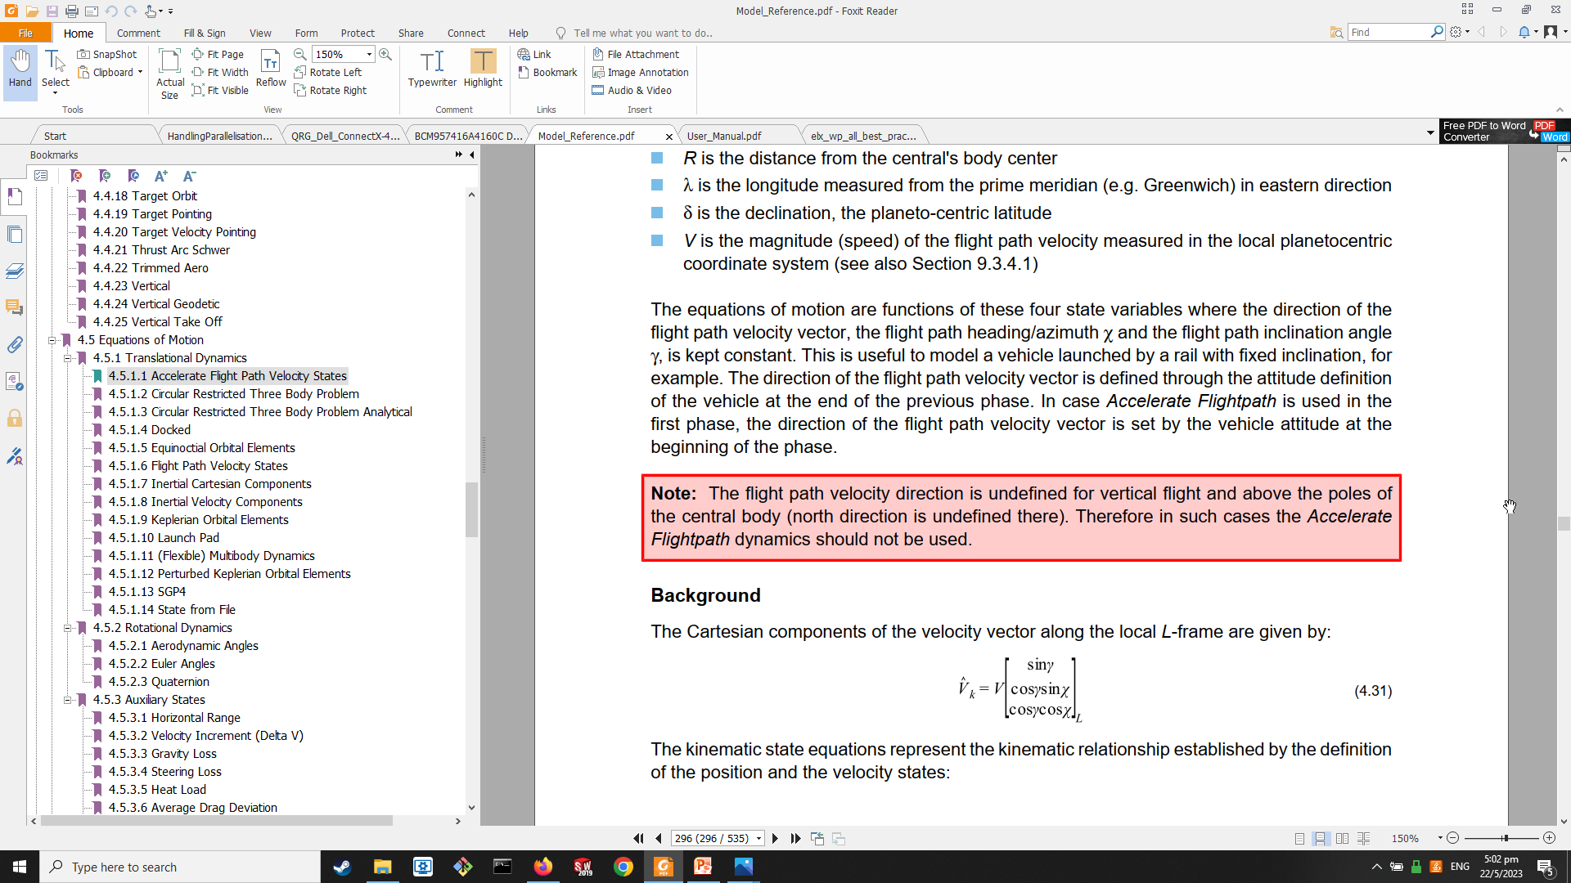
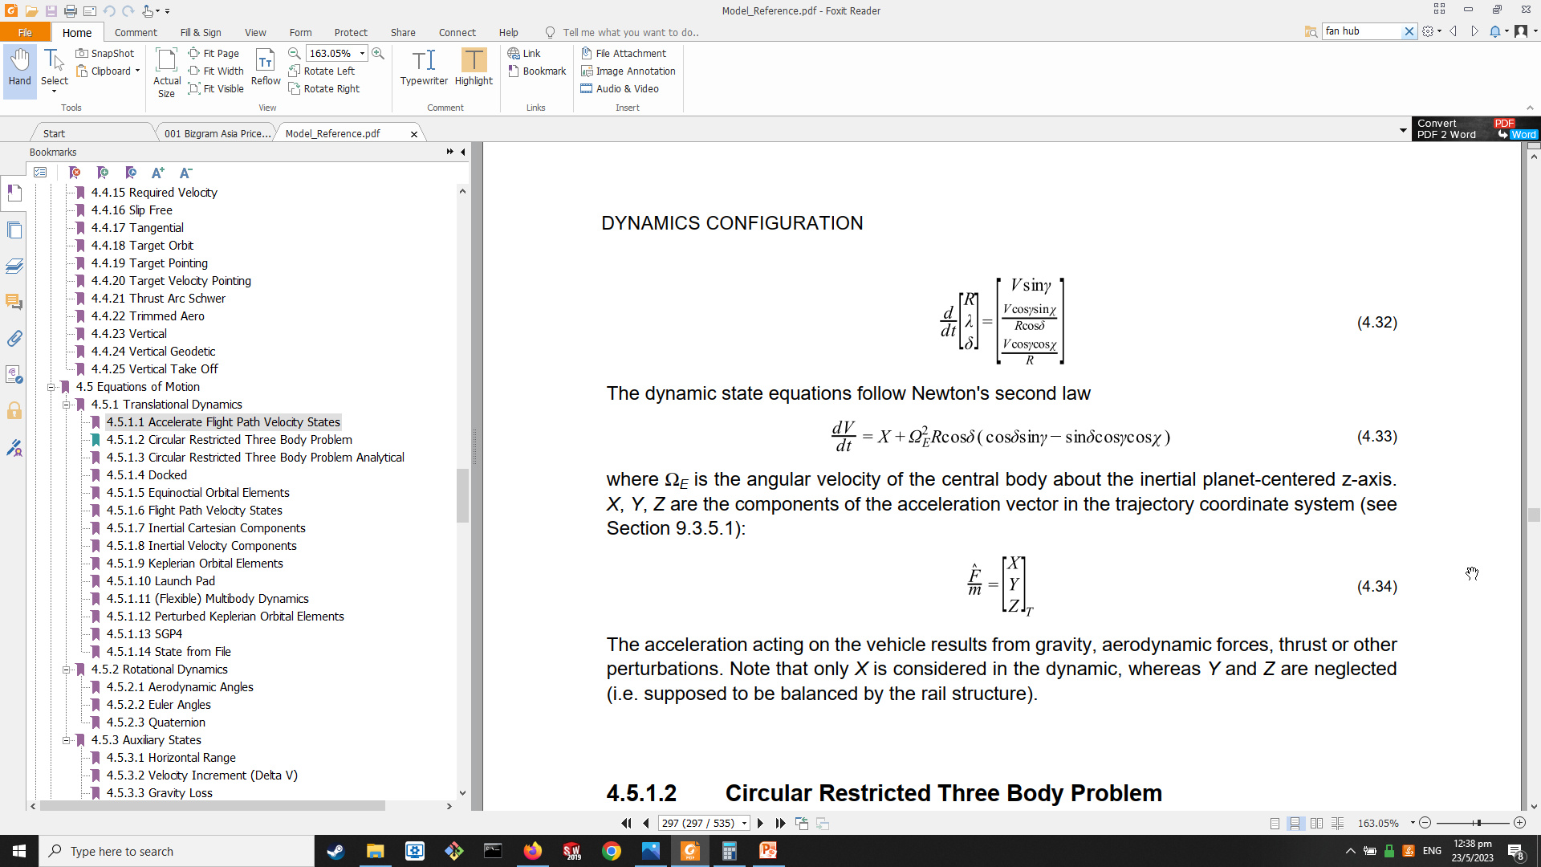
Trajectory Parameters
Equations of Motion: Accelerate Flight Path (Astos Model Reference)

Slide 39
Trajectory Parameters
Dynamics - Rail
Active motor

Slide 40

Trajectory Parameters
Dynamics - Thrust
Active motor

Slide 41

Trajectory Parameters
Dynamics - Coast
Full base drag – 0 km altitude
Inactive motor

Slide 42
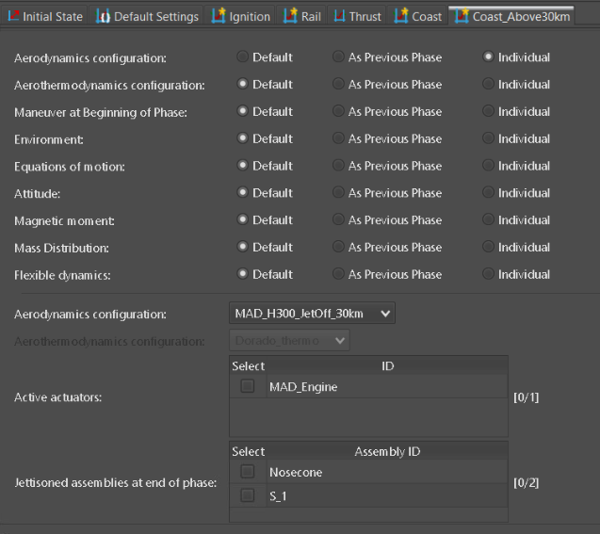
Trajectory Parameters
Dynamics – 2nd Coast Phase
Full base drag – 30 km altitude
Inactive motor

Slide 43
Modelling Guidelines
Focus on a single phase at a time
Disable later phases in the “Phases & Common Settings”
Use curve plots in the “Results” panel for verifying correctness of input/output data
Large aerodynamic tables (i.e. 2D) can be split into series of 1D tables for simulation
Consequently, the same increase in the no. of trajectory phases are required since each phase utilizes a different aerodynamic table

